Slide 1
Sprint 1 Status Update (FINAL INTERIM)
Team Safe Route
Wednesday, September 17, 2025

Slide 2





team Members
Kaustubh Deshetty Scrum Master
Charan Chalasani Product Owner
Sai Jayanth Kona Developer
Susmitha Chowdary Sunkavalli
Developer
Dinesh Ponnada Developer

Slide 3
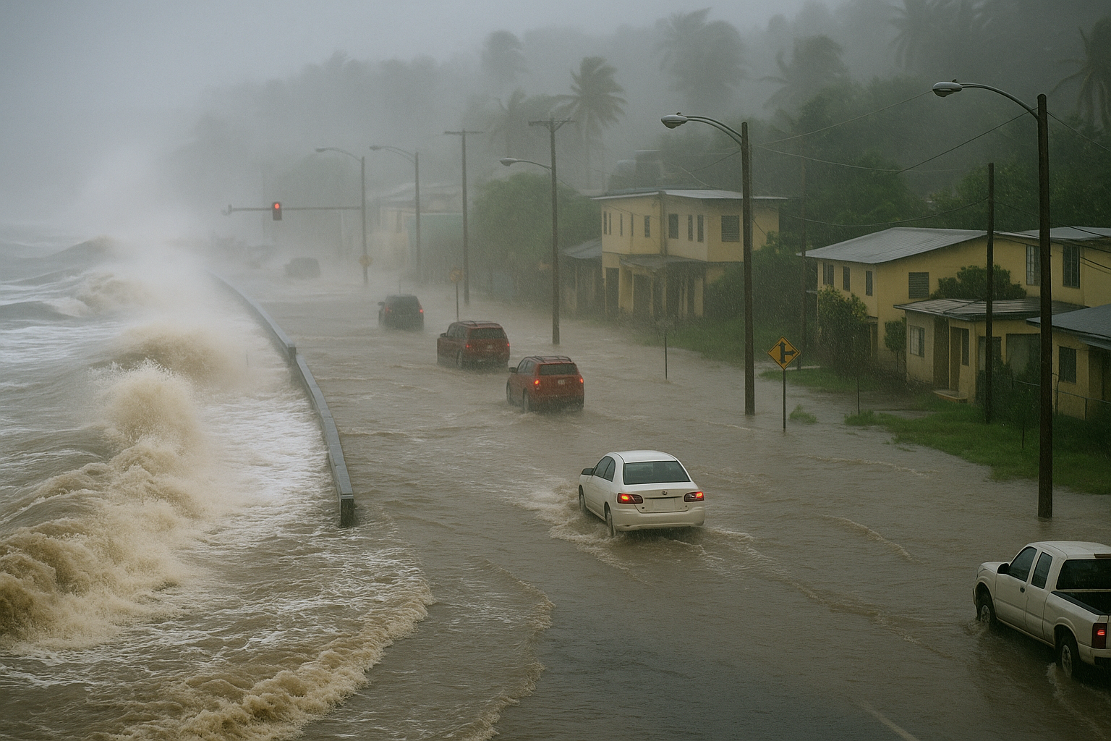
problem statement
Problem Context:
Domain of problem: Disaster management, emergency response, public safety, and transportation.
Importance of problem: Without a real-time evacuation routing system, residents of Puerto Rico face life-threatening delays during coastal flooding and severe weather. The inability to adapt evacuation routes to changing conditions increases vulnerability, disrupts access to hospitals and shelters, and puts entire communities at greater risk.
Problem Statement: During coastal flooding and severe weather events in Puerto Rico, evacuations are often delayed due to traffic congestion, road closures, and damaged infrastructure. Existing static evacuation plans fail to adapt to real-time conditions, leaving residents vulnerable and limiting access to critical services like hospitals, shelters, and fuel stations. The absence of a dynamic, data-driven routing system reduces preparedness and increases risks to human life. This project aims to develop a real-time evacuation platform that integrates live traffic, weather, and infrastructure data to optimize safe evacuation routes and continuously learn from past events for improved resilience.

Slide 4
Datasets
Proposed Datasets for Project [for each dataset]
Puerto Rico Department of Transportation and Public Works (DTOP): Manages Puerto Rico’s multi-tiered road network.DTOP Website
Puerto Rico Emergency Management Bureau (PREMB): Central agency for emergency preparedness.PREMB Website
NOAA Sea Level Rise Viewer: Visualizes the impacts of sea level rise on coastal communities. NOAA Viewer
USGS 3D Elevation Program (3DEP): Provides high-resolution LiDAR elevation data. 3DEP Portal
Puerto Rico Traffic and Emergency Data APIs: Includes real-time traffic data and emergency service locations.

Slide 5
Potential Analytics/algorithms
Algorithm | Core Idea | Strengths | Limitations | Fit For Project
Dijkstra | Explores all paths to find shortest route | Simple, reliable, hazard weights easy to add | Slower on large maps | ✅ Good baseline
A* | Uses heuristics to speed up search | Faster than Dijkstra, widely used in navigation | Needs good heuristic | ✅ Best choice
Bellman-Ford | Handles negative edge weights | Works where negatives exist | Very slow on large graphs | ⚠️ Not practical
Floyd-Warshall | All-pairs shortest paths | Finds all routes | O(V^3), too heavy | ⚠️ Only for small networks
Real-Time Routing | Uses live traffic/hazard data | Adaptive, realistic | Needs live feeds + integration | 🚧 Future scope

Slide 6
Project Schedule
Sprint | Interim 1 | Interim 2 | Final
Sprint 1 (Aug 27 – Sep 16) | Interim 1 (Aug 27–Sep 2) Introductions , roles, GitHub setup, Youtrack setup, probable use of algorithms | Interim 2 (Sep 3–Sep 9) Client meet, algorithms, problem approach, technology stack. | Final (Sep 10–Sep 16) Report + repo structured, risk log, Finalized System Architecture, Github access to client.
Sprint 2 (Sep 17 – Oct 1) | Interim 1 (Sep 17–Sep 23) | Interim 2 (Sep 24–Sep 27) | Final (Sep 28–Oct 1)
Sprint 3 (Oct 2 – Oct 16) | Interim 1 (Oct 2–Oct 6) | Interim 2 (Oct 7–Oct 11) | Final (Oct 12–Oct 16)
Sprint 4 (Oct 17 – Nov 3) | Interim 1 (Oct 17–Oct 23) | Interim 2 (Oct 24–Oct 28) | Final (Oct 29–Nov 3)
Sprint 5 (Nov 4 – Nov 22) | Interim 1 (Nov 4–Nov 10) | Interim 2 (Nov 11–Nov 16) | Final (Nov 17–Nov 22)

Slide 7
Risks and Planned Mitigations
Risk Name | Description | Probability | Impact | Mitigation
Limited Availability of Real-Time Data | Some datasets, like real-time traffic feeds and IoT-based flood sensors, may have restricted access or inconsistent availability. | High | Medium | Request early access to Puerto Rico Department of Transportation (DTOP) and PREMB data. Use historical traffic and flooding datasets for model pre-training until live data is integrated.
Integration with External APIs | Dependence on third-party APIs (e.g., dynamo DB data) means that any downtime or changes to the API could disrupt your service | Low | Low | Use multiple data sources for redundancy, and set up fallback mechanisms if certain services are temporarily unavailable. Also, monitor API usage limits and costs.
Cost Management | The cost of using third-party APIs (for maps, traffic data, emergency resources) can quickly add up, especially if the app grows in popularity. | Medium | Medium | Monitor API usage and consider building in-house solutions for certain features where feasible. Use cost-efficient APIs or negotiate better pricing models with service providers.

Slide 8
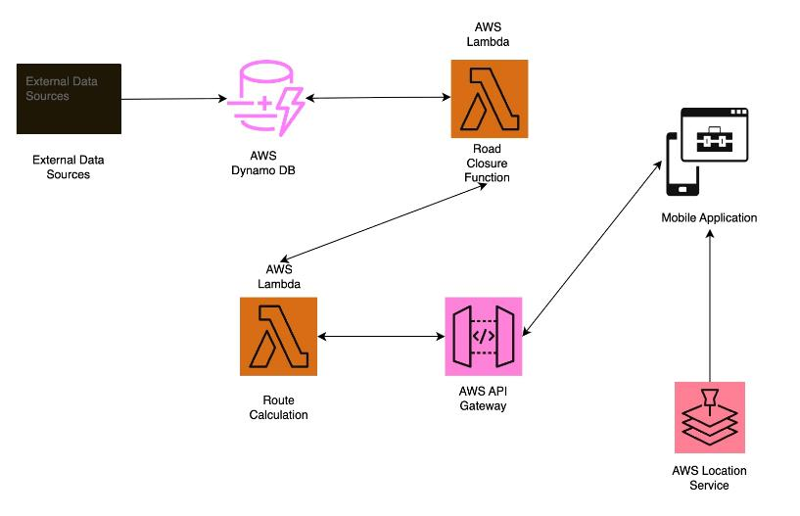
SYSTEM ARCHITECTURE

Slide 9
Weekly Partner Meeting
Partner name: Puerto Rico Science, Technology,& Research Trust – Caribbean Center for Rising Seas (CCRS)
Team Progress from Prior Week:
Finalized the maps for Puerto Rico, including road networks and flood-prone areas for evacuation planning.
Committed the base application along with the README to GitHub, providing a solid foundation for future development and collaboration.
Team Tasks for Current Week:
Installed the required infrastructure for the dynamic evacuation application, ensuring scalability and real-time data processing capabilities.
Conducted a thorough review of the architecture and tech stack, confirming that it aligns with the project’s needs and performance expectations.
Did a final review on the system architecture.

Slide 10
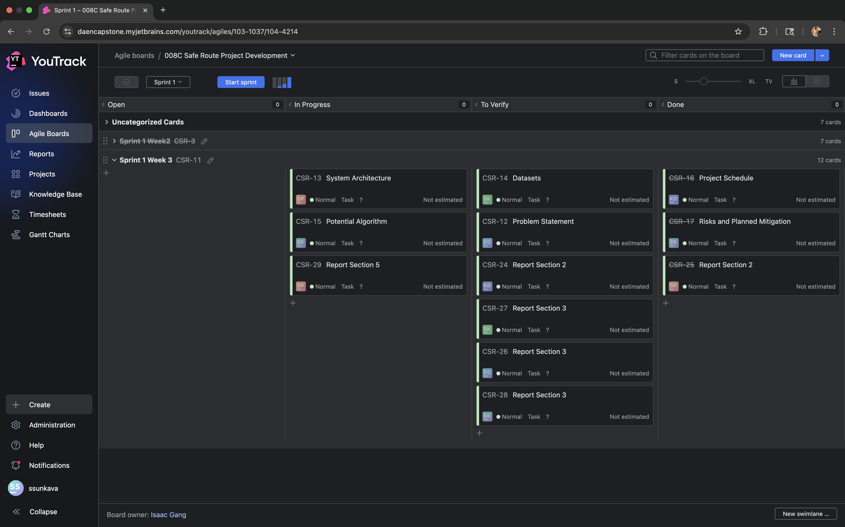
YouTrack

